Slide 1
PDF Accessibility Testing

Slide 2
Introduction
Accessibility
Tags
Tagged and untagged PDF Document
Methods to add a Tag
Document Properties
Structure Tags
Objects
Remediation Flows in PDF documents
Quick check on PDF documents
Appendix & References

Slide 3
Accessibility
Accessibility involves two key issues: how users with disabilities access electronic information and how web content designers and developers enable web pages to function with assistive devices used by individuals with disabilities.
A PDF document is considered accessible if it can be used/accessed by everyone, including people with disabilities; this includes access by people who are blind, visually or cognitively impaired or color-blind. An accessible PDF makes it easier for people with disabilities to access PDF documents with the aid of assistive technology software and devices, like screen magnifiers, screen readers, speech-recognition software, text-to-speech software.
Tagging a PDF is the single most important step you can take to ensure accessibility.PDF tags provide a hidden, structured representation of the PDF content that is presented to screen readers. They exist for accessibility purposes only and have no visible effect on the PDF file.
There is more to an accessible PDF file than tags, but an untagged PDF would not be considered "accessible“
There are 3 Acrobat Tools:
Acrobat Reader allows user to view and interact with a PDF (including the accessibility features of a PDF), but it cannot be used to create new PDFs or edit existing ones.
Acrobat Standard adds the ability to create a PDF, along with other features like converting a scanned PDF to a searchable file. However, you cannot view or edit accessibility information.
Acrobat Pro is the only version of Acrobat that can be used to view and edit the accessibility information of a PDF.
Assistive Technologies | Type
JAWS | Screen Reader
NVDA | Screen Reader
ZoomText | Magnifier tool
Dragon Naturally Speaking | Voice Recognition Tool

Slide 4
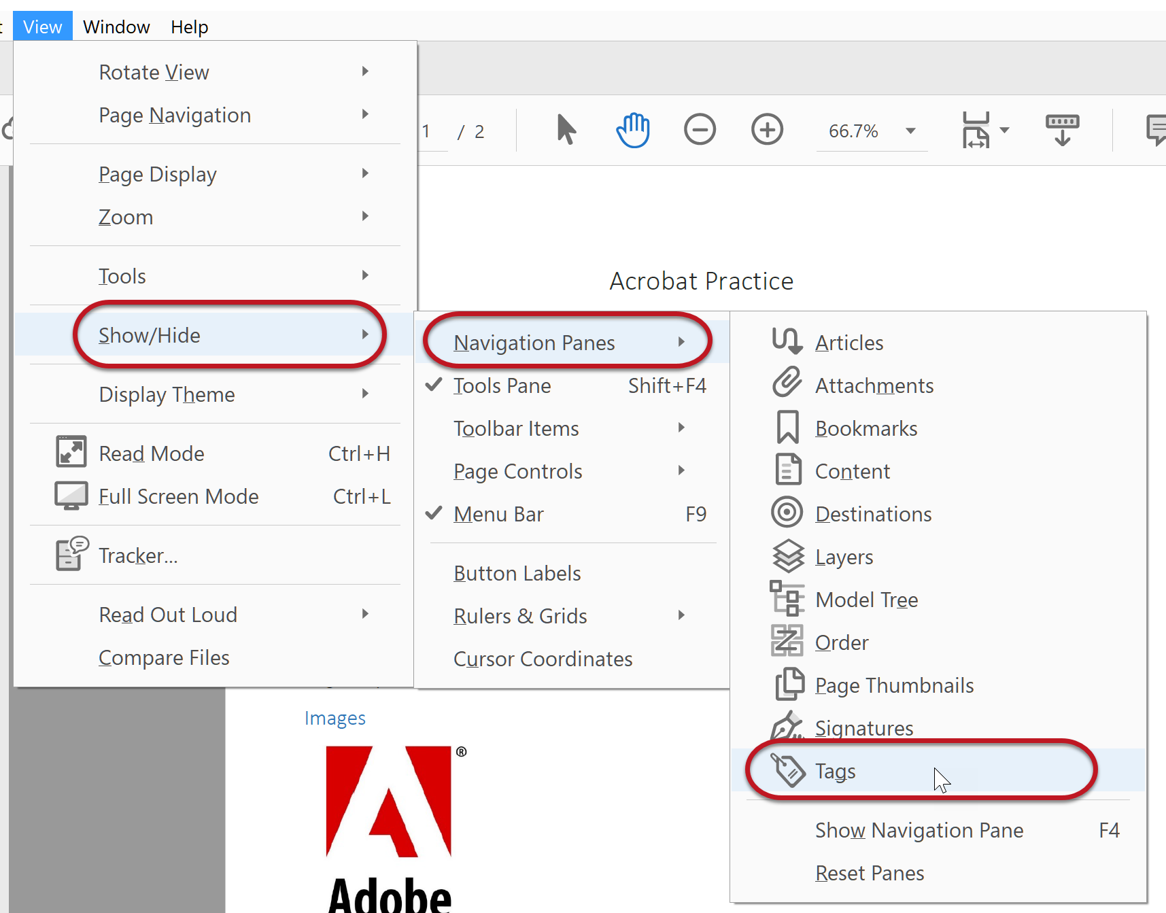
TAGS
Tags are invisible labels that provide significant information about elements in the document.
Tags provide the semantic structure that conveys what a document is about and how it’s organized. This information is passed on to assistive technologies, which then pass it on to their users. When every element of a document has semantic meaning, screen reader users can understand how the document is organized and can navigate through it efficiently
Example :
A screen reader user needs the headings to be explicitly, semantically labeled (tagged) as such, in order for their screen reader to recognize them as headings. When they are properly tagged, a screen reader user can conveniently jump from heading to heading

Slide 5
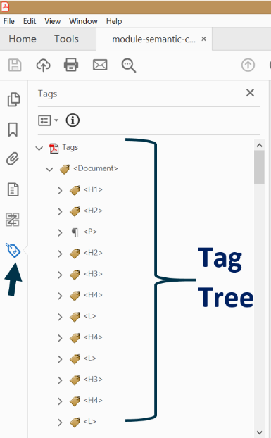
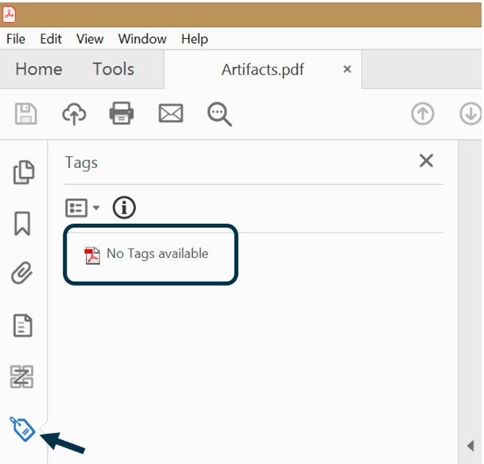
Tagged and untagged document
Tagged Document Untagged Document

Slide 6
methods to manually add a tag
Directly in the tag tree
Working with Tag tree is similar to html tagging.
Create the tag and associate the content simultaneously
Using the Reading Order Tool
The Reading Order Tool (previously known as Touch Up Reading Order Tool or TURO) allows you to add and edit tags.
It accomplishes the exact same thing as adding and editing tags directly in the tag tree, but it’s a more visual way of tagging content.
The Reading Order Tool simultaneously creates the tag and associates the content with it.

Slide 7
Document Properties

Slide 8
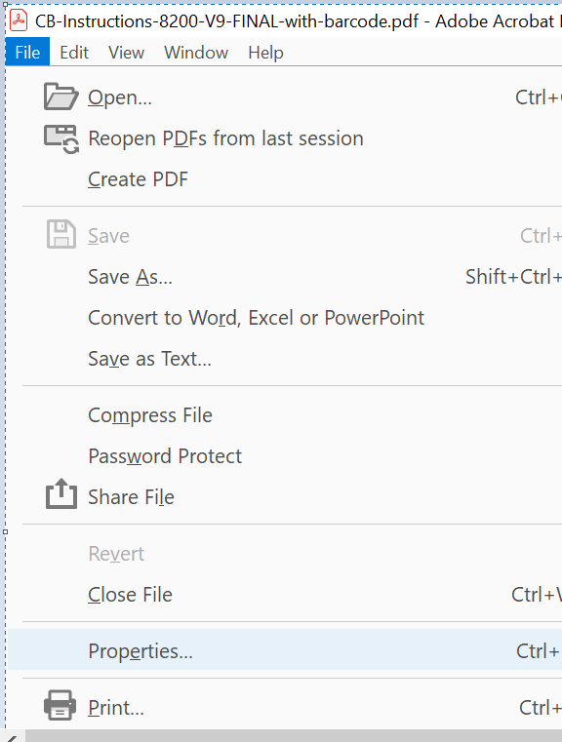
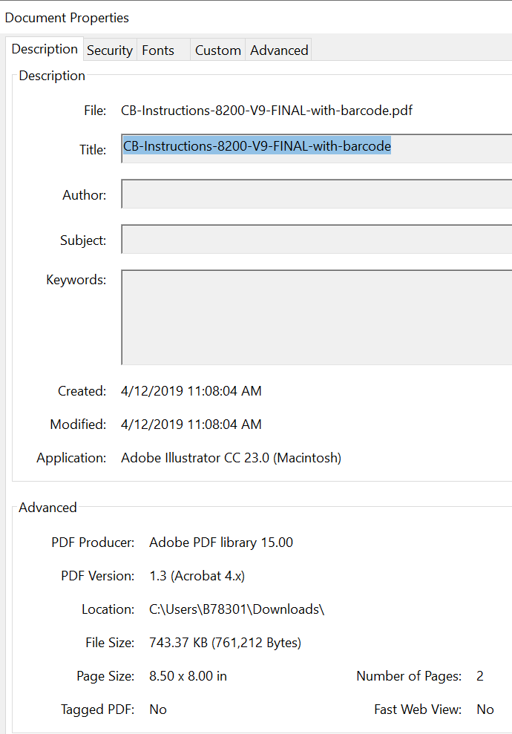
Descriptive filename
(2.4.2 Page Titled - Level A)
Document titles identify the current location without requiring users to read or interpret page content
Select File > Properties
Select the Description tab to view the metadata in the document, including the document information dictionary
Modify the Title field to add or change the document's Title entry
Note : A file's title is not necessarily the same as its filename

Slide 9
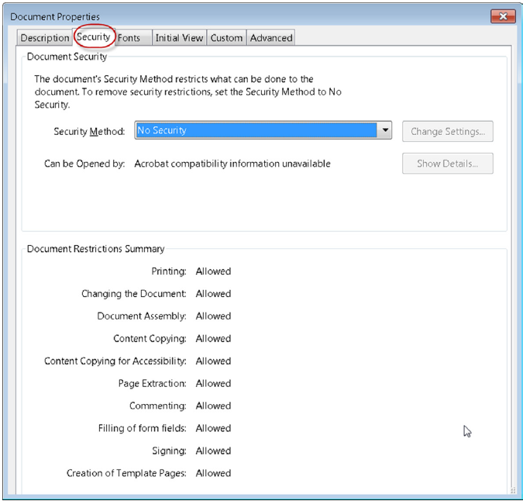
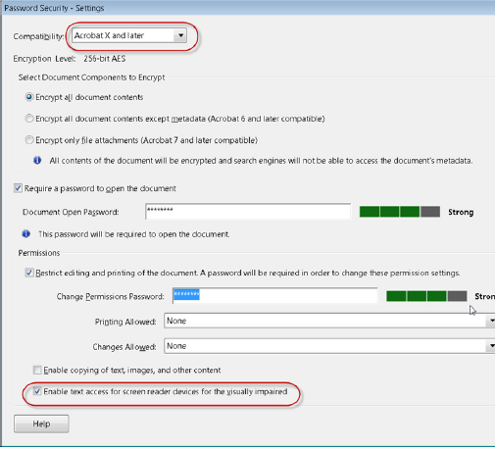
Assistive technology
The text of an accessible PDF must be available to a screen reader. Ensure that security settings don’t interfere with the screen reader’s ability to convert onscreen text to speech.
Select File > Properties
Select the Security tab of the document properties dialog.
If no security is set, by default this will allow the assistive technologies to access the documents.
If security is required , select password security as the security method from the dropdown list. In the Permission section password security - settings dialog , verify the box labelled Enable text access for screen reader devices for the visually impaired is checked.

Slide 10
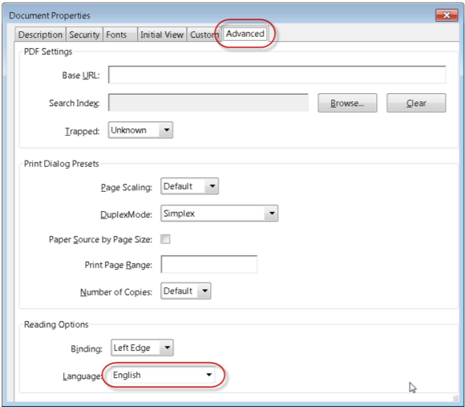
Document language
(3.1.1 Language of Page - Level A)
Setting the document language in a PDF enables screen reader to switch and read the appropriate language efficiently.
Select File > Properties
Select the Advanced tab of the document properties dialog.
Select language from the Reading options section.

Slide 11
Structure Tags

Slide 12
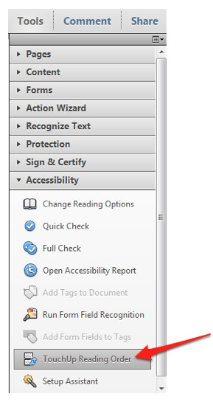
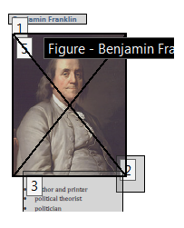
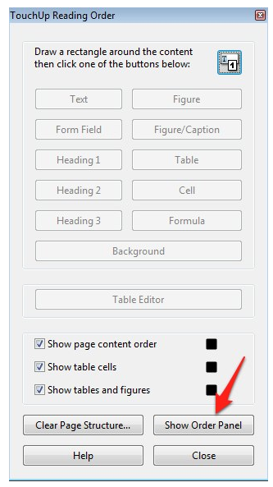
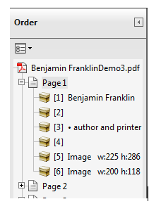
Order of the document
(2.4.3 Focus Order - Level A)
Choose Tools, Accessibility, Touch Up Reading Order.
The numbers on the boxes around your content indicate the current reading order of the document.
In the Touch Up Reading Order window, choose Show Order Panel.
In the Order Panel, you can change the reading order by opening the desired page and using drag and drop.

Slide 13
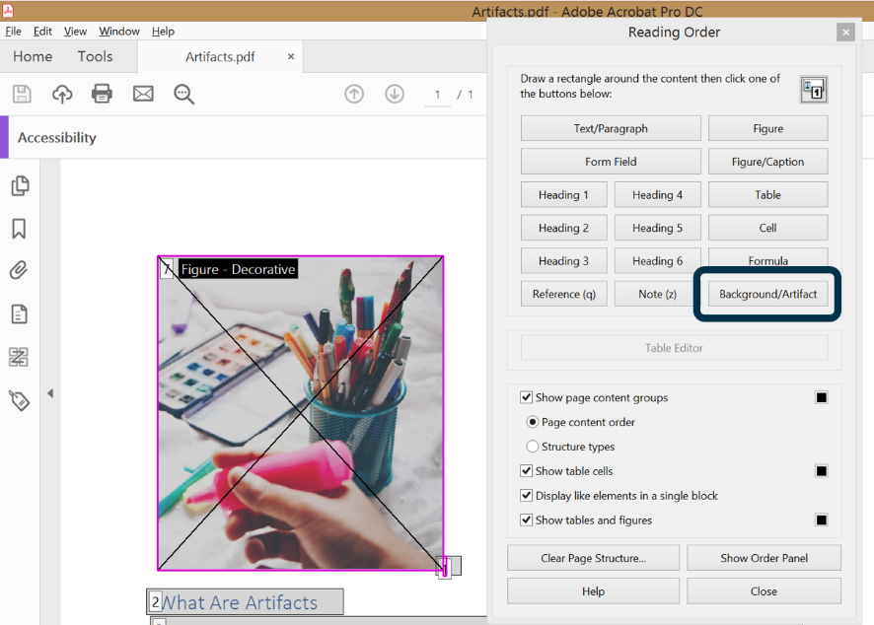
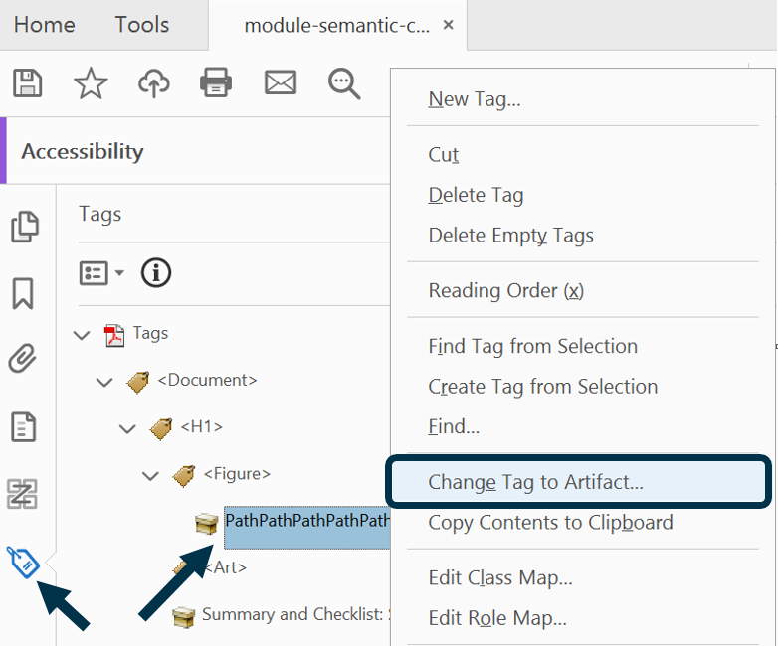
Decorative Contents
Screen readers should ignore content, such as decorative images, you must mark those items as Artifacts
Using the Reading Order Tool
Open the Reading Order Tool. (Tools > Accessibility > Reading Order)
Use the cursor (now displayed as crosshairs) to select a zone around the element.
Select the Background/Artifact button in the Reading Order tool.
The content will be turned into an Artifact. Note that it will no longer be displayed in the tag tree.
To mark multiple items as Artifacts at once, hold down the Shift key while selecting the zone around each one, and then select the Background/Artifact button.
Using the Tags Pane
You can also turn items that have already been tagged into Artifacts. This is often necessary when you’re working with an automatically tagged document during manual touch-up.
Open the Tags Pane.
Right-click the content that needs to be labeled as an Artifact (not the tag itself, but the content within it, which is next to the container icon that looks like a little box).
Select Change Tag to Artifact.

Slide 14
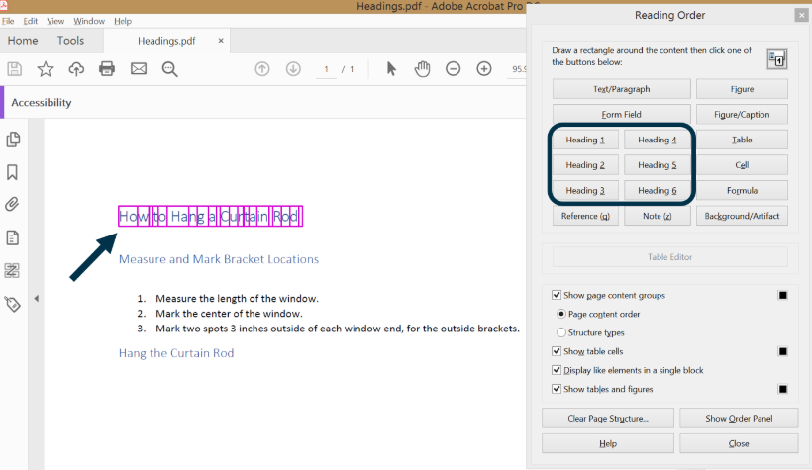
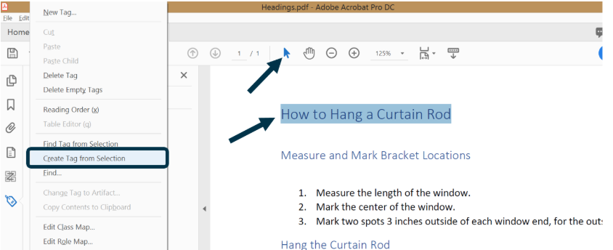
Heading Tags
Using the Reading Order Tool
Open the Reading Order Tool.
Draw a box around the heading.
Select the button that corresponds to the heading level you're creating (1 through 6).
Using the Tags Pane
Click the Selection Tool.
Select the heading.
Open the Options Menu in the Tags Pane.
Select Create Tag from Selection.

Slide 15
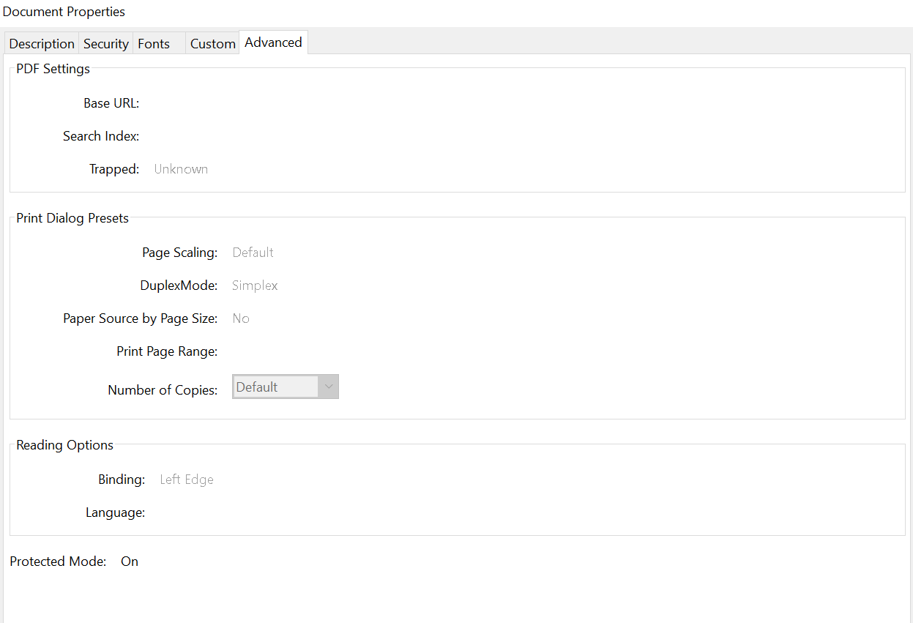
Lists & Language
Lists
Assistive technologies allow users to navigate from list to list or item to item. If the lists are not correctly formatted with list tags, these users will have difficulty understanding the list content.
Lists are comprised of three or sometimes four tag types:
List: <L>
List Item: <LI>
List Body: <Lbody>
Label: <Lbl>
Language
For assistive technologies (e.g., screen readers) to present your document accurately, it is important to indicate
the natural language of the document.
Open the document in Adobe Acrobat Pro
From the File menu, select "Properties..."
In the "Properties" dialog, select the "Advanced" tab
In the "Reading Options" field, select the default language from the "Language" combo box
Steps to Tag Lists

Slide 16
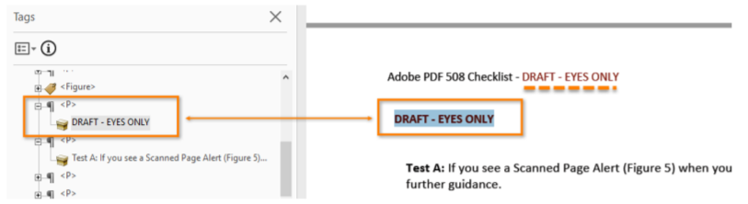
Vital Information
Vital information in headers, footers, and watermarks should be duplicated in the PDF document
Locate the first page or section the vital information applies.
Highlight the second instance of the vital information on the same page.
Open the “Tags” pane (View > Show / Hide > Navigation Panes > Tags). Find the tag corresponding to the vital information. (Tags Pane > Find Tag from Selection).
Vital information should be tagged.

Slide 17
Objects

Slide 18
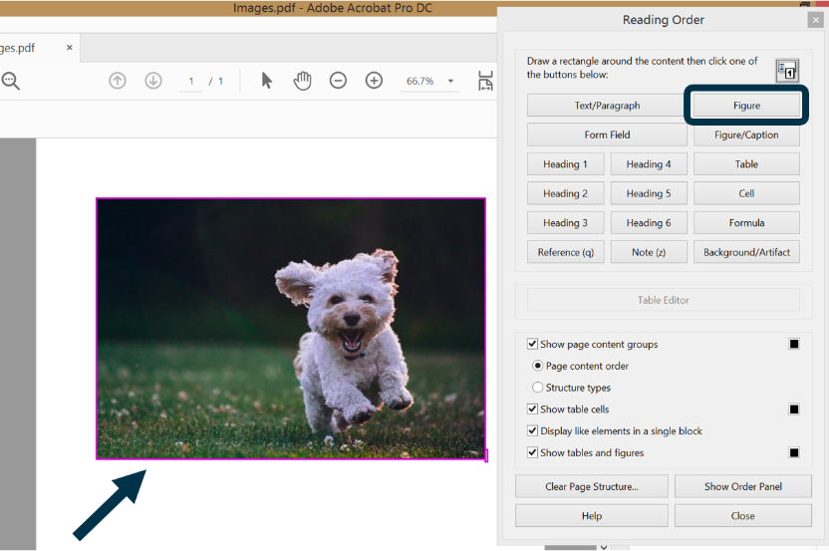
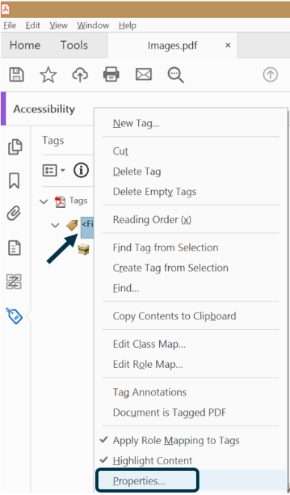
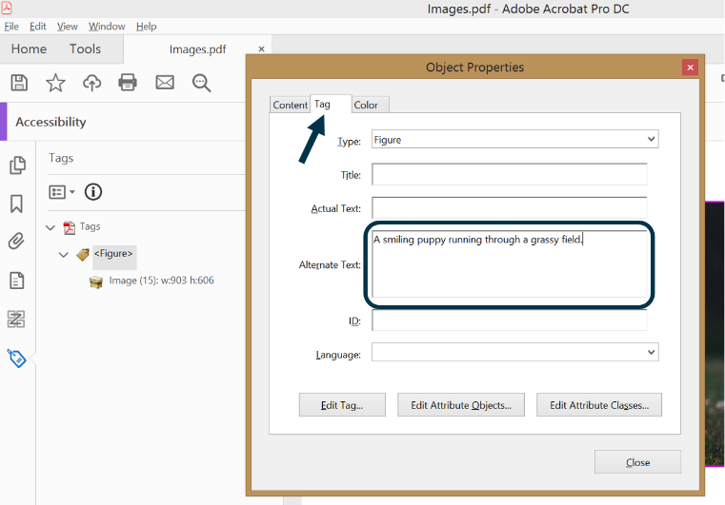
Images without caption
Image alt text
Images that convey meaning/information should be tagged with the <Figure> tag and given alternate text.
Using the Reading Order Tool
For an image without a caption:
Open the Reading Order Tool.
Select the image by drawing a box around it with your cursor.
Click the Figure button in the Reading Order Tool.
Open the Tags Pane.
Right-click the Figure tag.
Select Properties.
In the Tag tab, enter the alt text in the Alternate Text field. Note: if you click out of this dialog before you close it (for example, switching to a different program window), the alt text you just typed will disappear and you'll need to retype it.

Slide 19
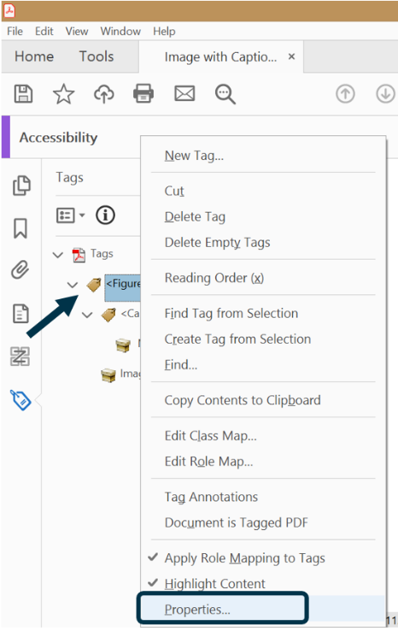
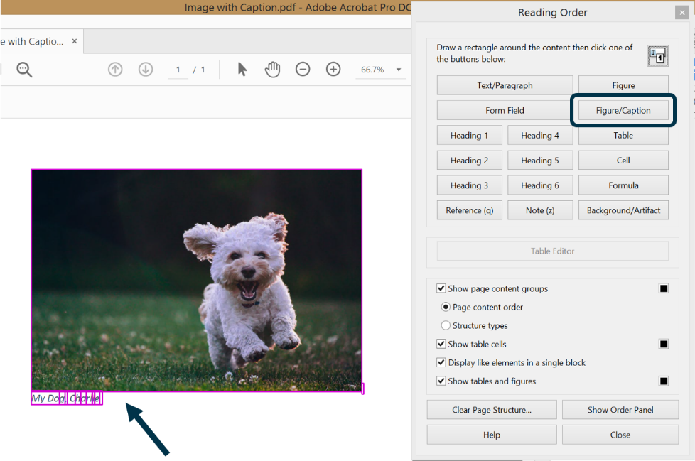
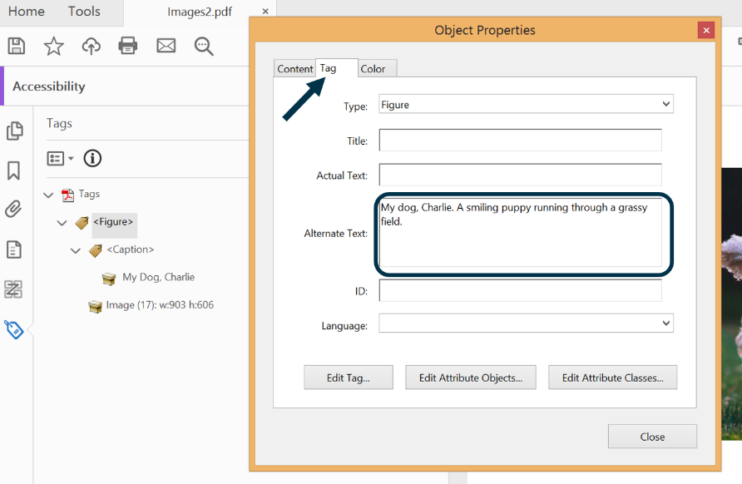
Images with caption
For an image with a caption:
Open the Reading Order Tool.
Select the image and caption by drawing a box around them with your cursor.
Click the Figure/Caption button in the Reading Order Tool.
Open the Tags Pane.
Right-click the Figure tag.
Select Properties.
In the Tag tab, enter the alt text in the Alternate Text field, if the caption does not fully describe the image. In the alt text, you can include the text of the caption itself, and also additional information to fully describe the image
Note : Placing a description in the Alt Text field on the figure will override the caption text, and a screen reader will not read the caption (it will only read the alt text).

Slide 20
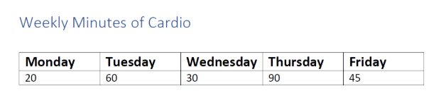
Tables
When using tables, it is important to ensure that they are clear and appropriately structured. This helps all users to better understand the information in the table and allows assistive technologies (e.g. screen readers) to convey context in a meaningful way.
Table elements are special elements for structuring tables. When it comes to marking up a table, these special elements are:
<Table> - the Table element. A two-dimensional arrangement of data or text cells that contains table row elements as child elements and may have a caption element as its first or last child element.
<TR> - the Table row element. One row of headings or data in a table, that may contain table header cells and table data cells.
<TH> - the Table header cell element. A table cell that contains header text or data describing one or more rows or columns of a table.
<TD> - the Table data cell element. A table cell that contains regular data, or non-header data
Data tables in PDFs must be tagged as “Table.” Column and row header cells must be tagged as “Table Headers”. Find all programmatically identified tables and check if table header cells are tagged as table headers.
Steps to Tag Data Tables

Slide 21
Links, controls, Tooltips and Forms
Links and controls must:
1. Be uniquely identified
2. Describe the destination, function, and/or purpose in the name or within context
3. Be in a tab order that matches the visual/logical order of interactive elements (links, controls,
and form fields)
An accessible link tag has 2 parts:
Link tag: <Link>
Link-OBJR annotation: <Link-OBJR>
Tooltips and Forms
All form fields must have a tooltip and the tool tip must match its label or instruction.
Press the tab key to find form fields (text fields, radio buttons, checkboxes, combo boxes, etc.).
The tab order must match the visual layout of the form.
Steps for Tooltips and Forms
Steps to Tag Links

Slide 22
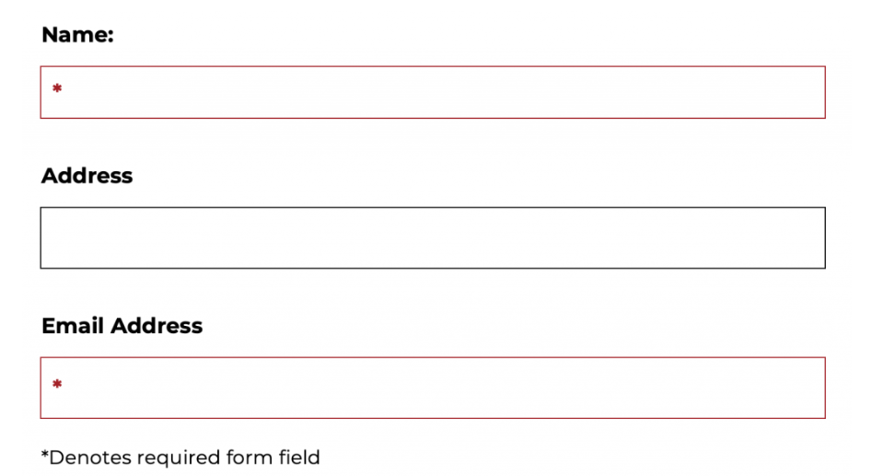
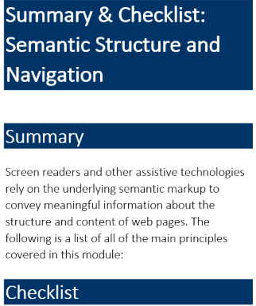
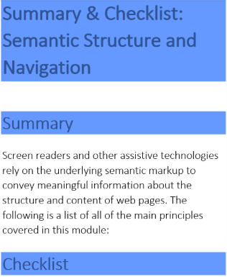
Color and Contrast
Color
Using only color or other visual characteristics to convey meaning will not provide comparable access to people who are blind, have low vision, or are colorblind.
Forms when listing mandatory fields uses a common practice to mark these mandatory fields in red text to indicate they must be completed. Using red text alone to indicate the mandatory fields is a violation of the WCAG 2.1 Criterion 1.4.1. There needs to be more than just the use of color in indicating mandatory fields such as an icon that indicates a mandatory field such as below.
Color contrast
“The visual presentation of text and images of text has a contrast ratio of at least 4.5:1, except for the following:
Small Text against the background: 4.5 to 1 min ratio with the background
Small text is under 18 point regular or 14 point bold
Large Text against the background: 3 to 1 min ratio with the background
Large text is at least 18 point regular or 14 point bold
User Interface Components and Graphical Objects: 3 to 1 min ratio against adjacent colors

Slide 23
Container Tags
Container elements are the highest level of element and provide hierarchical grouping for other block-level elements.
These tags do not convey any semantic meaning to the document.
They are used to organize the tag tree structure and are more for the benefit of the document author than the end user.
They will not be picked up or announced by screen readers, but they might be very helpful to find your way around in a long document..
Container Tags
<Document> — the Document element. Used as the root element of a document's tag tree.
<Part> — the Part element. Used to structure a large division of a document, like a chapter or sometimes a page. May group smaller units of content together, such as division elements, article elements, or section elements (see below).
<Div> — the Division element. A generic block-level element or group of block-level elements.
<Art> — the Article element. A self-contained body of text considered being a single narrative within a larger group of content.
<Sect> — the Section element. A general container element type, which is usually a component of a part element or an article element.

Slide 24
Table Tags
Using the Reading Order Tool
Open the Reading Order Tool.
Draw a box around the heading.
Select the button that corresponds to the heading level you're creating (1 through 6).
Using the Tags Pane
Click the Selection Tool.
Select the heading.
Open the Options Menu in the Tags Pane.
Select Create Tag from Selection.

Slide 25

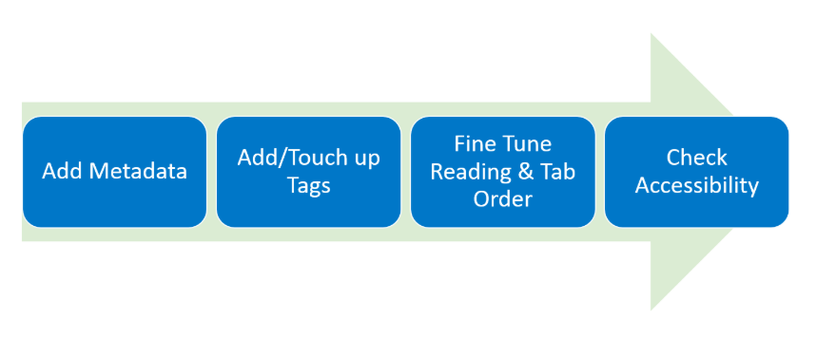
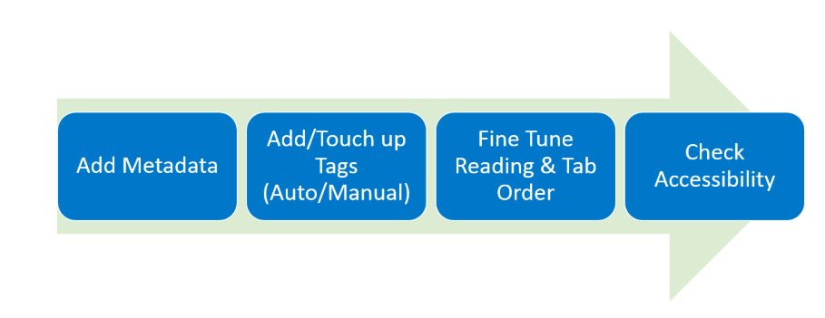
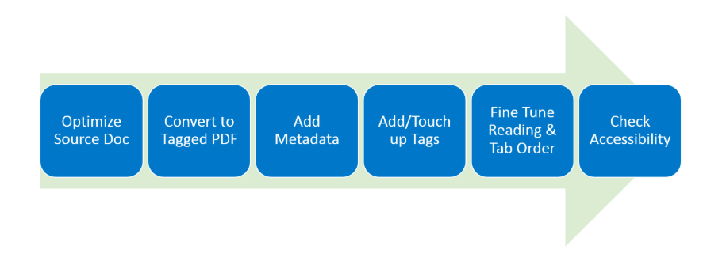
Remediation Flows in PDF documents
If you have access to the source document
Optimize the original source document for accessibility.
Convert the source document to tagged PDF.
Add metadata.
Add or touch up the tags.
Fine tune the reading order and tab order.
Check the acessibility of your efforts.
Poorly tagged PDF
Add metadata.
Add or touch up the tags.
Fine tune the reading order and tab order.
Check the accessibility of your efforts.
Untagged PDF
Add metadata.
If the document is very simple, you can autogenerate tags in Acrobat Pro.
Otherwise, create the tags manually.
Touch up the tags.
Fine tune the reading order and tab order.
Check the accessibility of your efforts.

Slide 26
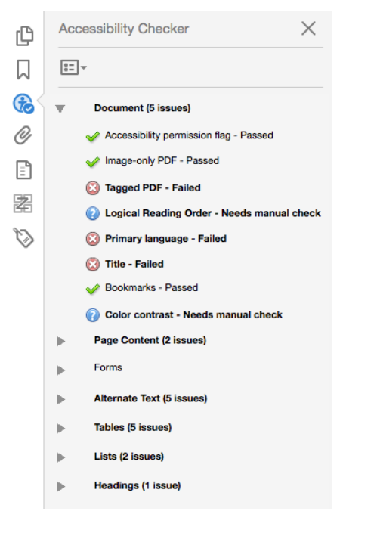
Quick Check on PDF ( 1 of 2)
#1 Run a scan
The first thing you can do is use Adobe’s accessibility checker to spot weak points. This can’t catch everything but it gives you a feel for the accessibility of a document.
#2 Check and fix text
If your old PDF’s text is an image (to find out if it is, just try and select the text), use Adobe optical character recognition (OCR) to convert the image to actual text.

Slide 27
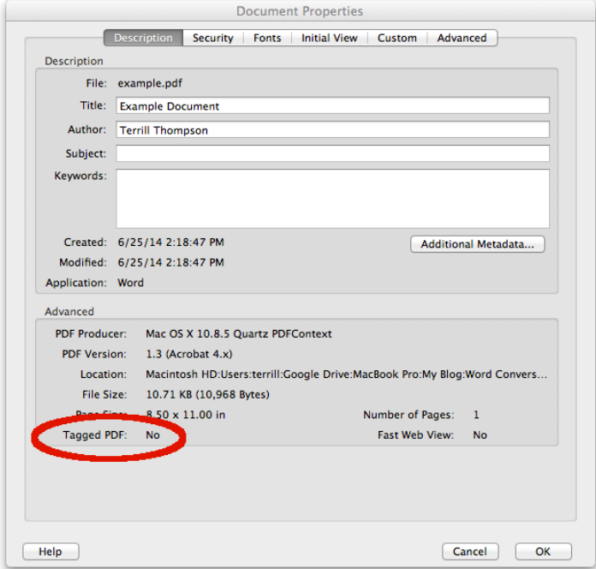
Quick Check on PDF ( 2 of 2)
#3 Check for tags, optimize tags
An accessible PDF will always be tagged. First, make sure tags are in place and then make sure 1) the tags are correct and 2) the tags are showing in logical order.
#4 Manually (or double) check other items
Inspect the following:
Meaningful images have descriptive alt text
Links use descriptive anchor text (note: if not created properly in the source document, hyper links can be inaccessible even if they are active. Click Edit PDF and then link to accessibly remediate links)
Language and document title are present
Document contains important bookmarks

Slide 28
Accessibility checks in PDF
Tags provide assistive technologies with an outline or structure of the PDF that can help interpret the content and the reading order of the document to their users. This outline is hidden from sighted viewers unless they open up the tag sidebar menu..
Accessible PDFs should have the below properties :
document title
assigned language
implementing heading structure <H1>, <H2>, etc.
correct tag usage and alignment
alt text
descriptive links
logical reading order
no images of text
color contrast ratio
text zoom up to 200%
not using color alone to convey information

Slide 29
Appendix & References
Document Name | Attachments
PDF Accessibility Checklist
PDF Accessibility Cheat sheet
Links and Resources :
PDF Checklist : https://www.ssa.gov/accessibility/checklists/pdf/pdfchecklist.html
PDF File 508 Checklist : https://www.hhs.gov/web/section-508/making-files-accessible/checklist/pdf/index.html
Create Accessible PDFs : https://www.section508.gov/create/pdfs

Slide 30
THANK YOU

